Slide 1



From Homemakers to Entrepreneurs
Women’s Journey to Financial Independence

Slide 2

Introduction
-Women have traditionally been homemakers, but many are now becoming successful entrepreneurs.
-Factors like financial independence, self-growth, and digital opportunities have empowered them.
-Overcoming societal and personal challenges is part of this journey.

Slide 3



Challenges Faced by Homemakers
-Lack of Financial Resources: Limited access to capital.
-Social Expectations: Family responsibilities and gender roles.
-Lack of Business Knowledge: Limited exposure to entrepreneurship and formal training.

Slide 4


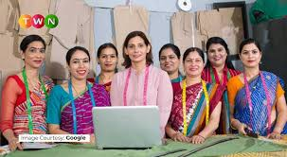
Path to Entrepreneurship
-Skill Development: Online courses, self-learning, and workshops.
-Leveraging Digital Platforms: Social media, e-commerce, and freelancing.
-Support Networks: Government schemes, women entrepreneur programs, and family support.

Slide 5
THANK YOU FOR YOUR TIME!
“When women support each other ,incredible
things happen.”
Let’s keep empowering and growing together!

